Slide 1
WELCOME TO
PYTHON WORKSHOP

Slide 2
TITLE
A SIMPLE ALIEN SHOOTER PYTHON PROGRAM
TEAM NUMBER : 21
TEAM NAME : 3K PROGRAMMERS
TEAM MEMBERS: M.KARTHIKEYAN
N.KAVITHA
A.KEERTHANA

Slide 3
ACADEMIC MENTOR Er SATHISH R M.E.,(PhD).,
INDUSTRY MENTOR
MS.SUBASHINI U
ASSOCIATE
KGISL GSS

Slide 4
ABSTRACT
The title of the game is alien shooting game. The main aim is to destroy the aliens and keep moved to the higher levels. In this game the spaceship loaded with many missiles to attack the upcoming aliens. If you destroy the alien , one point will be added to the scorecard. For each destroy , one point will add to your scorecard. N number of aliens will come from the top of the screen , we want to destroy all the aliens by moving spaceship will destroy. So we want to destroy the aliens simultaneously protecting our spaceship normally in this game , the keys are collapsed and difficult to move the ship and shoot the aliens. I change the keys ( LEFT , RIGHT , UP , DOWN , SPACE ) to move the spaceship easily and shoot the enemies. I also include to see the high scores by saving that after the game is over.

Slide 5
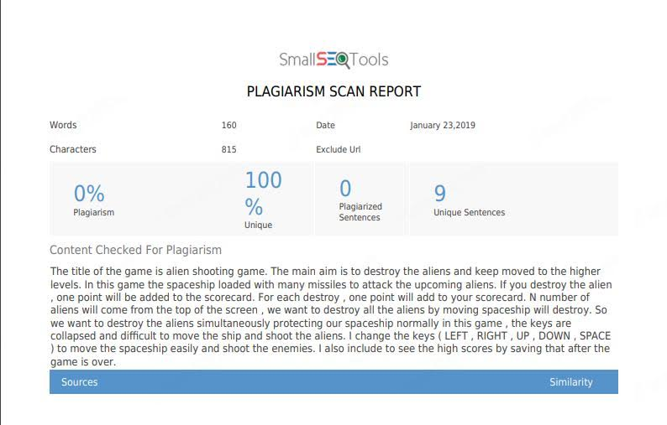
plagiarism

Slide 6
MODULES
ENTER THE GAME
START BUTTON FOR START THE GAME
LEFT ARROW KEY TO MOVE LEFT
RIGHT ARROW KEY TO MOVE RIGHT
UP ARROW KEY TO MOVE UPWARDS
DOWN ARROW KEY TO MOVE DOWNWARDS
SAPCE KEY TO LAUNCH MISSILE
HIGHSCORE OPTION TO VIEW THE SCORES
NAME OF THE PLAYER
SCORE OF THE PLAYER
ACCURACY OF THE PLAYER
SOUND
ON OPTION
OFF OPTION
QUIT OPTION TO QUIT THE GAME

Slide 7
Requirements
SOFTWARE
Thonny
Pygame
HARDWARE
8GB RAM
INTEL(R) CORE(TM) i5-6500 CPU@ 3.20GHz

Slide 8
MODEL ARCHITECTURE
ENTER THE GAME
CHOOSE START GAME OPTION TO PLAY THE GAME
USE DIRECTION ARROW KEYS TO MOVE THE SHAPCESHIP
TO SHOOT THE ALIEN PRESS SPACE KEY
EACH DESTROY OF ALIEN WILL INCRESE THE SCORE BY ONE POINT
YOU SHOULD DESTORY THE ALIENS AND SIMULTANEOUSLY PROTECT THE SPACESHIP
LEVELS ARE KEEP ON INCREASING AND SPEED OF THE ALIEN TOO
IF ANY ALIEN TOUCH THE SPACESHIP THE SPACESHIP WILL DESTROY
IF THE GAME IS OVER IT WILL ASK THE NAME OF PLAYER TO SAVE THE NAME AND THEIR SCORE IN HIGHSCORE OPTION
IF YOU WANT TO QUIT THE GAME CHOOSE THE QUIT OPTION

Slide 9
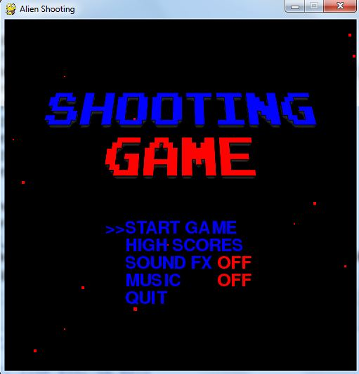
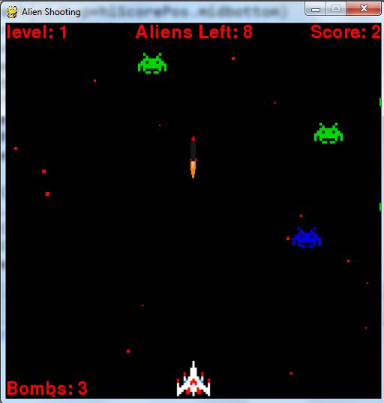
Screen Shot
Shooting game

Slide 10
SAMPLE CODE
import pygame
import random
from collections import deque
from sprites import (MasterSprite, Ship, Alien, Missile, BombPowerup,
ShieldPowerup, Explosion, Siney, Spikey, Fasty,
Roundy, Crawly)
from database import Database
from load import load_image, load_sound, load_music
if not pygame.mixer:
print('Warning, sound disabled')
if not pygame.font:
print('Warning, fonts disabled')
BLUE = (0, 0, 255)
RED = (255, 0, 0)
direction = {None: (0, 0), pygame.K_UP: (0, -2), pygame.K_DOWN: (0, 2),
pygame.K_LEFT: (-2, 0), pygame.K_RIGHT: (2, 0)}

Slide 11
CONCLUSION
Python code for a pygame is developed and the output is obtained successfully

